Slide 1
JOURNEY PPT Technical Onboarding - Week I
Afrin Siddiqui – IDA
Supervisory Organization: PTIY/FBD CC HR and Corporate (Pankaj Janak Kumar) (59726509)
Position Title: 54077724 Associate Data Engineer
Location: Bangalore RMZ-ECO WORLD
Employee ID: 654991

Slide 2
Day 1 – Introduction to AGILE
Learned about the flexible development technique called AGILE.
In depth knowledge about frameworks such as SCRUM.
Performed group activity to learn the concept of AGILE.
Performed individual tasks on Microsoft Azure.

Slide 3
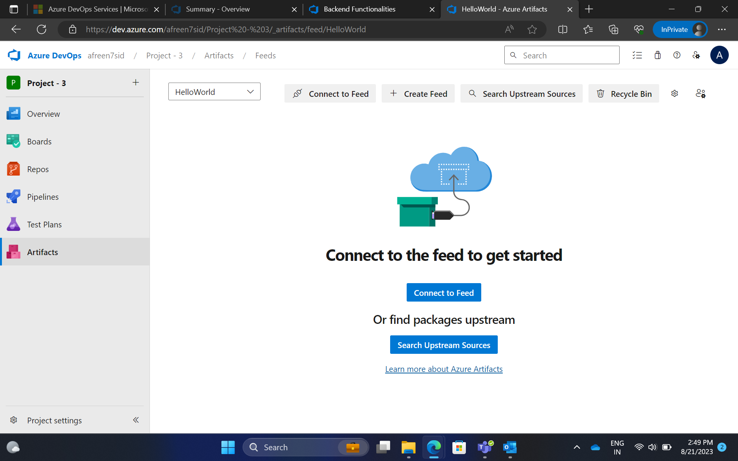
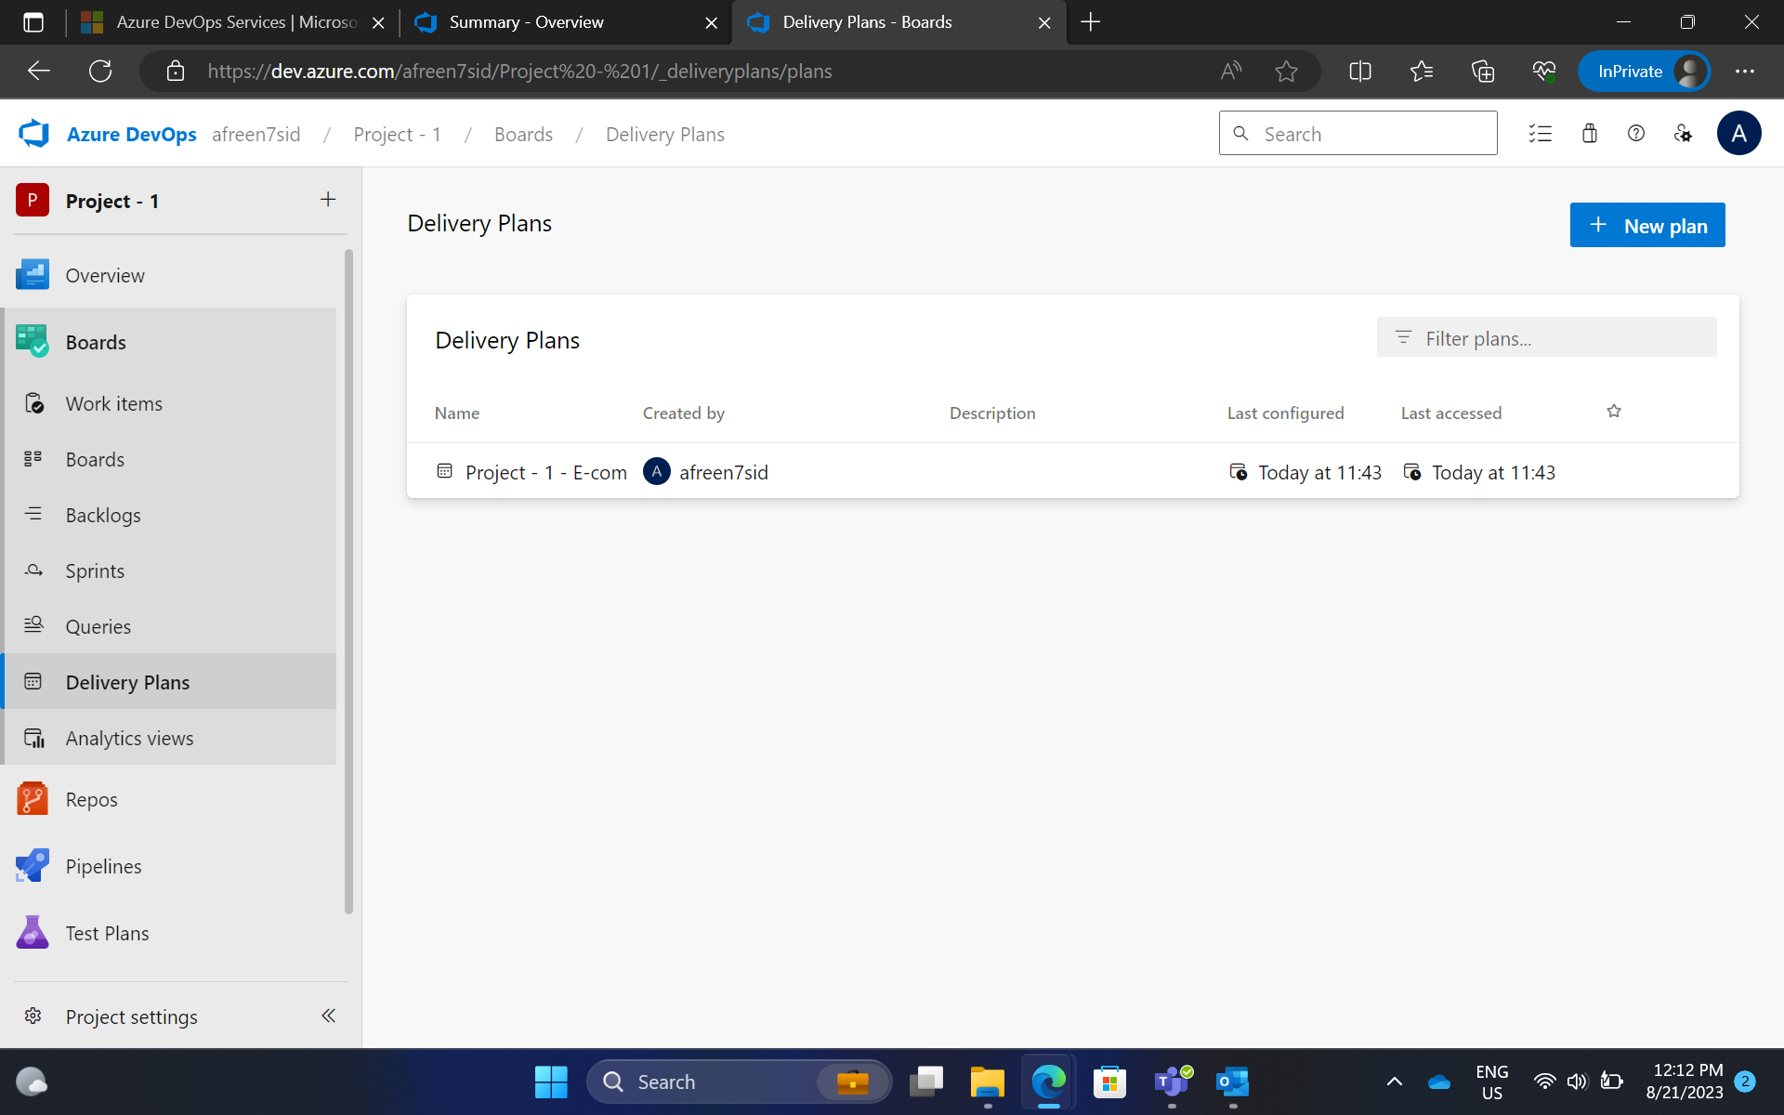
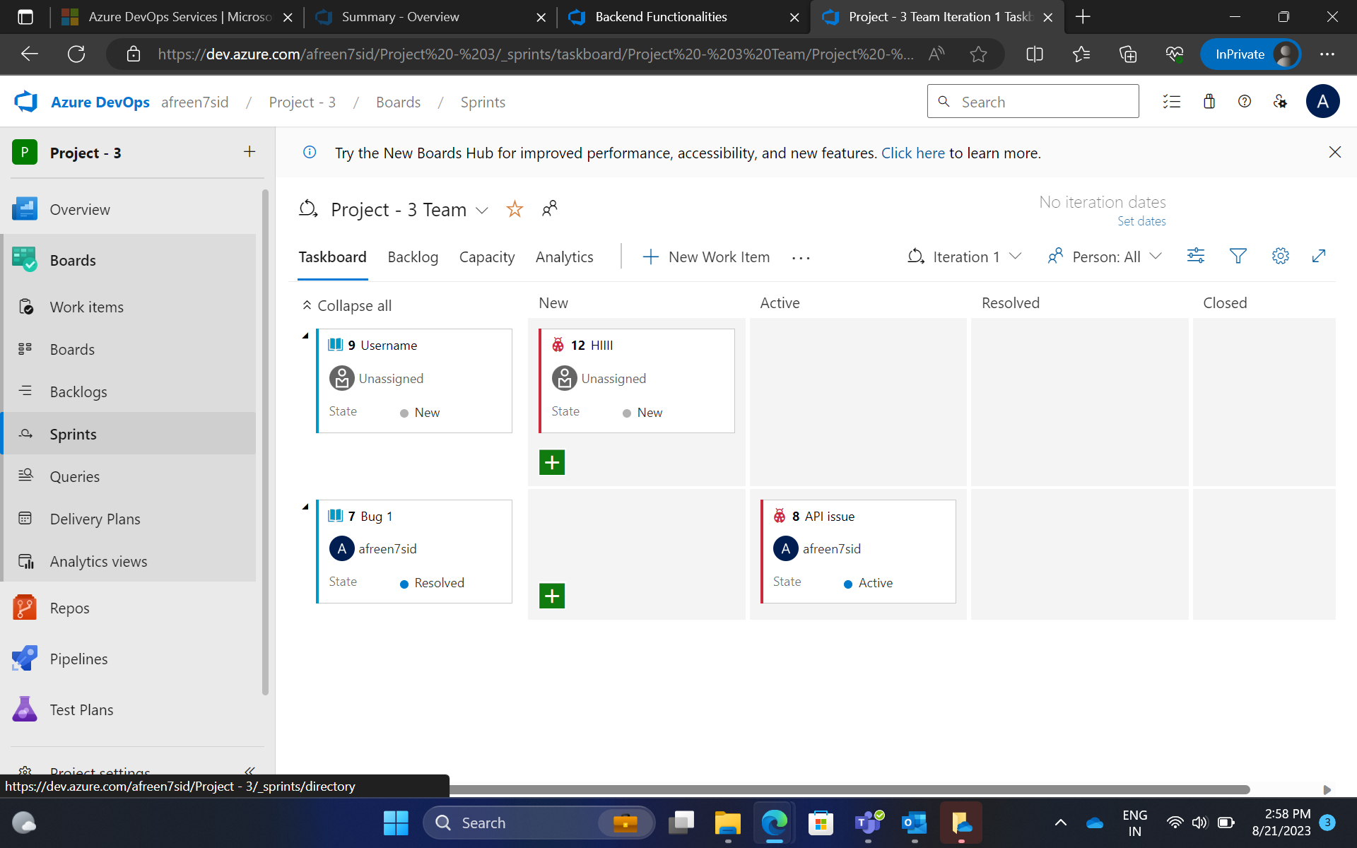
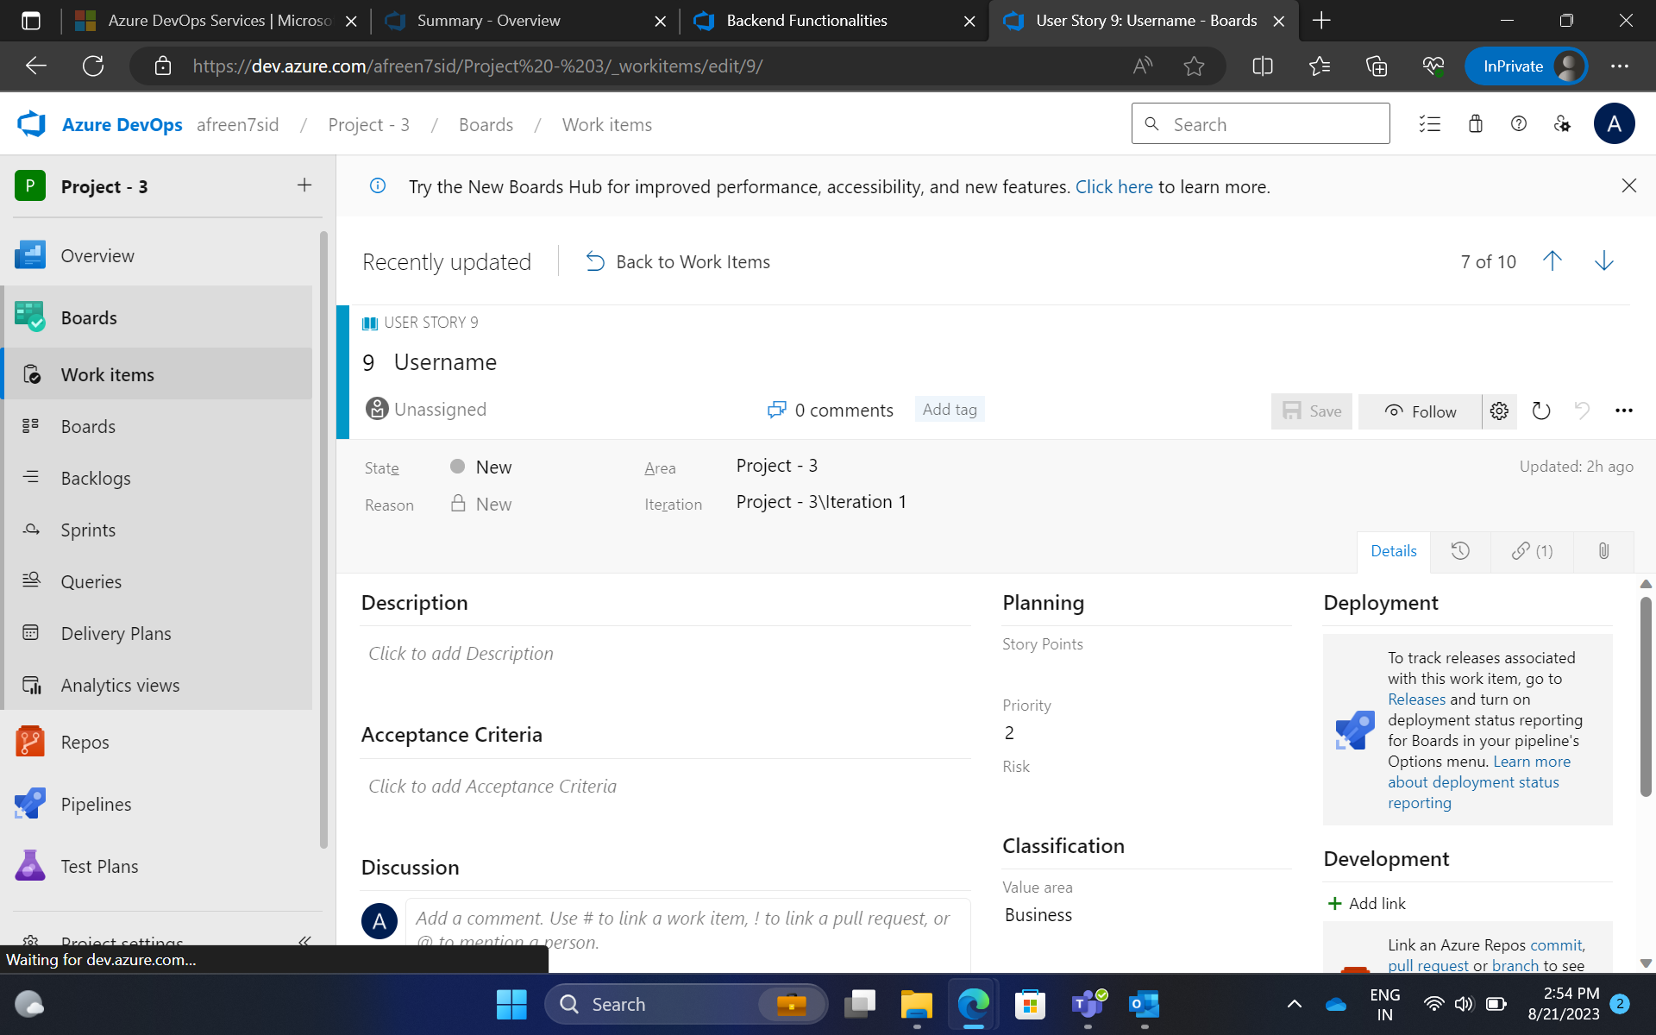
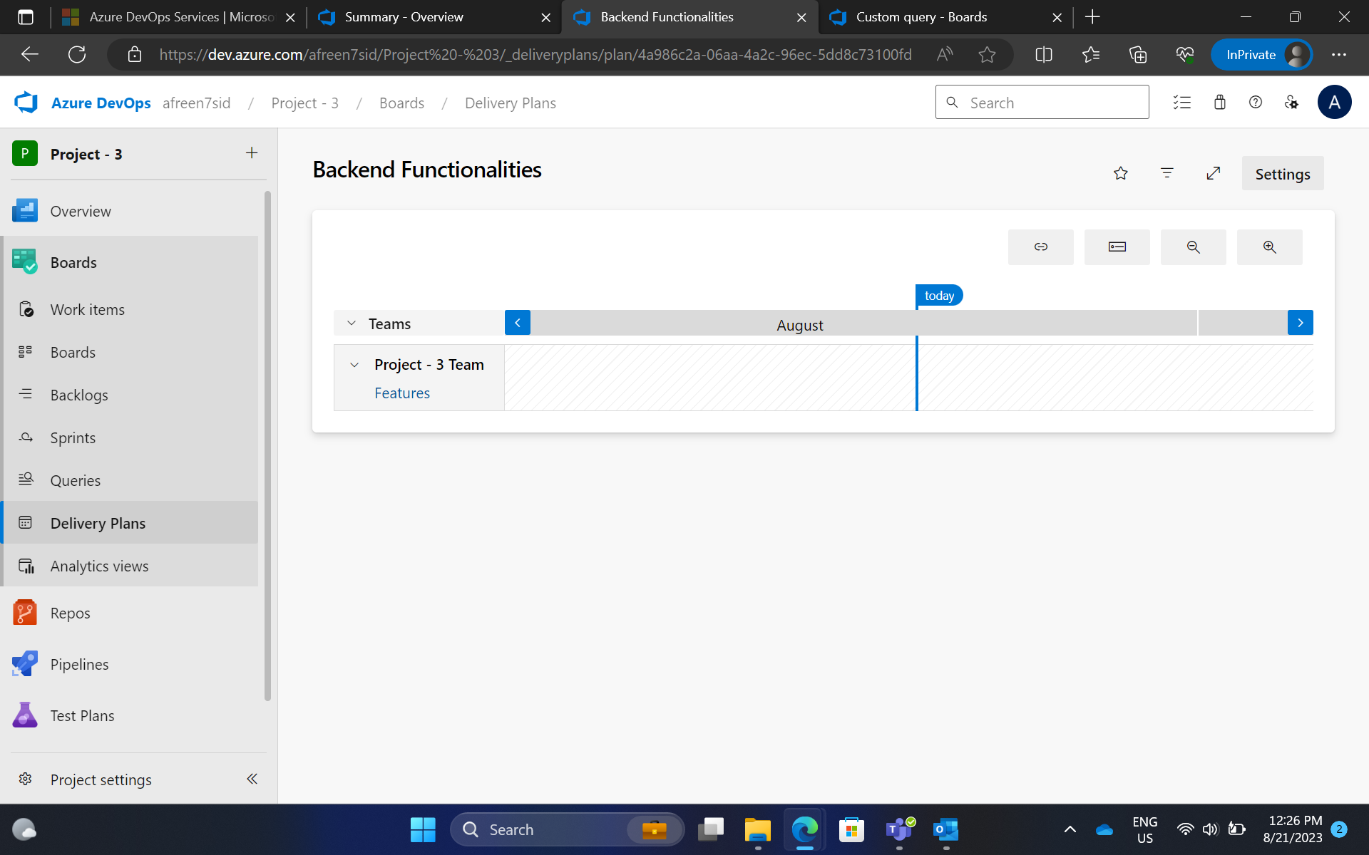
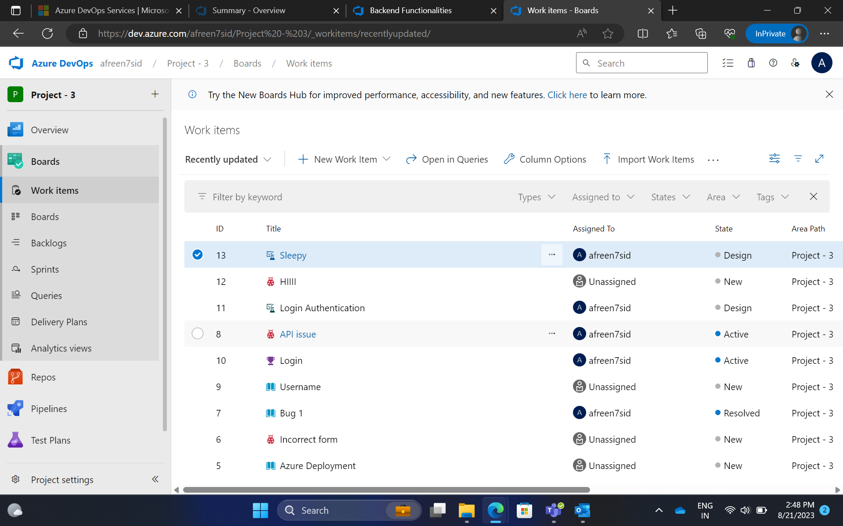
Day 1 - Hands on training/Practical Work

Slide 4
Day 2 – Introduction to DBMS
Learned about the different types of databases.
Brief introduction to SQL operations: DDL, DQL, DML, DCL, TCL
Performed SQL commands and created a database.
Team activity: Presentation about the various joins and fucntions in DBMS.

Slide 5
Day 3 – Introduction to Software Testing
Brief dive into the development life cycles – SDLC & STLC.
Learned about the concept of defect testing.
Started working on project starting with the use – case, data flow diagram, user stories and test cases.
Learned about the two types of testing – Static & Dynamic.
Finished the first assessment of the week. (AGILE + Business Analysis)

Slide 6
Day 4 – AGILE & DevOps
Learned about the DevOps cycle which includes stages such as Plan, Code, Build, Test, Release, Deploy, Operate, Monitor.
Concept of continuous integration; tools such as Jenkins and Selenium.
Brief introduction to configuration tools such as Puppet and Ansible.
Concept of containerization was introduced as well.

Slide 7
Day 5 – DevOps tools & Cloud Computing
Concept of DevOps tools was explained.
Github actions were taught and also automation of integration.
Brief introduction to Cloud Computing and Cloud Service Models.
Virtualization and main purpose of cloud computing was explained.
Cloud sourcing and its benefits.
Team Activity: Continued to work on project and presentation.
Performed github actions in VM

Slide 8
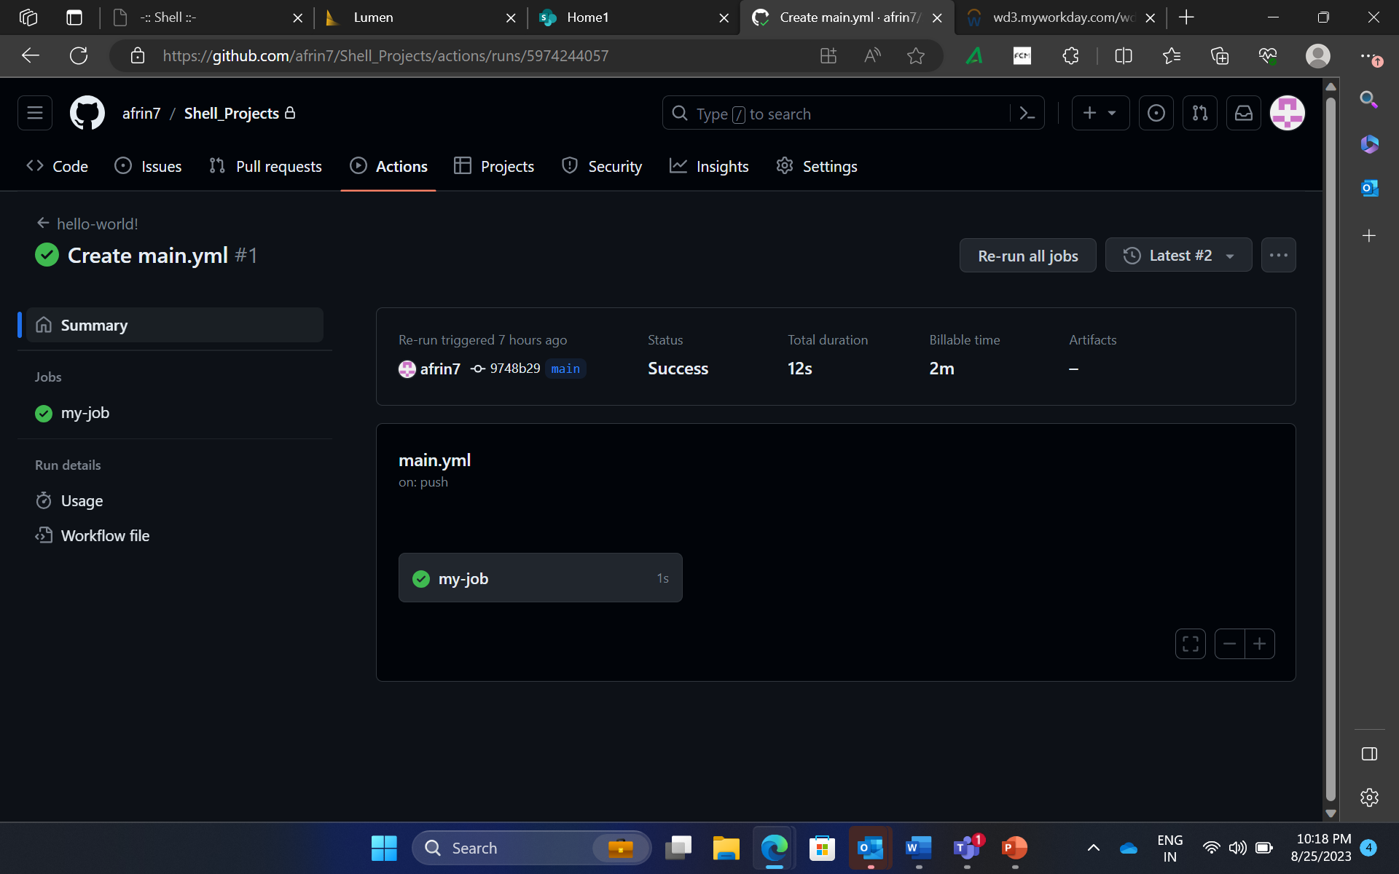
Day 5 – Hands on training/Practical Work

Slide 9


